Slide 1






Hugo Mercier
Vincent Sacquin
Gregoire Taja
Anton Chernysh
Umair Iftikhar
Ali Basaran

Slide 2

THE CHALLENGE
Improve the quality of Heretics service to their sponsors through blockchain technology

Slide 3


Sponsors
Improve the service received from Heretics to the sponsors by increasing their profit and detailed information of the perceived return of the investment.
PROBLEMS
TO SOLVE
Heretics
Increase the value of the brand and its advantages by being its sponsor.
Fans
Improve the relationship between Heretics and their fans by offering them advantages.

Slide 4







THE SOLUTION
A unique Heretics Soulbound Token (HST) that links
Heretics team, the fans and the sponsors

Slide 5
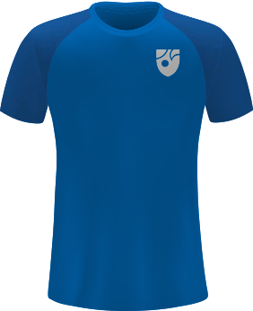


WHAT THIS TOKEN WILL BRING?
The unique link between all the stakeholders.
1. Identification
2. Special benefits
3. Data centered
Every Heretic's fan will have the right to claim a token that formally identifies him/her as a fan of Heretics in any sponsor's application
This fan token will grant special benefits for heretic's fan on partners application, driving revenue for sponsors and engagement to heretics' community
This token will allow heretics' team and sponsors to know more about its fan base with important data such as number of fans and engagement.

Slide 6



For sponsors
New clients
Return on investment
Granular data
The sponsoring companies will obtain an increase in their number of users that will come from the followers of Heretics
Sponsor companies will be able to quantitatively measure the return on their investment in collaborating with Heretics
Each new customer is linked to a unique identifier, which allows information on their behavior in maximum detail.

Slide 7


For Fans
Discounts
Exclusive services
The main advantage for the fans are the discounts obtained through the sponsors. The higher the fan status, the greater the discounts and advantages obtained.
Supporting Heretics and their sponsors will increase your level, which will allow you to participate in raffles and exclusive events.

Slide 8



For Heretics
New fans
New sponsors
Database
The additional services offered by our product will attract new users and fans to the Heretics page. It will aslo increase the engagement from the current fan base.
This token will increase the value of Heretics' team as brand, driving more sponsors' interest and raising the average bid offer.
The information collected by user behaviors and routines of use of the sponsors' services offers Heretics a valuable database that will help the team understand more its fan base.

Slide 9



TRADITIONAL METHOD
Content creators collaborate with companies like Amazon to promote products and redirect their audience to E-commerce websites
These people are usually influencers who use or talk about similar products and offers them links with discounts to those products
If you are interested in this product, help me, by using the link below:
https://amzn.to/123abc123

Slide 10
HERETICS SOULBOUND TOKEN (HST)
Our product consists of a token linked to each Heretics user
that allows them to obtain different services and
discounts from sponsors and Heretics.
We explain the operation of our token, how it is obtained and
how it allows to obtain the mentioned advantages.

Slide 11

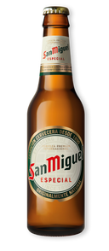


OUR SOLUTION: HST
The Heretics Soulbound Token (HST) is a combination of user identification and their engagement score. It has the same benefits of the traditional method but combined with blockchain technology .
The user is able to obtain HST through interaction with Team Heretics. The more fan points a user gains, more advantages they will have through the sponsors and Team Heretics.
In the left example, after the user logs their crypto wallet to sponsor's page, he can obtain different discounts as for example a free beer from Heretics sponsor, San Miguel.
It may even be possible to use QR codes at stores to verify one's Heretics Token and receive discounts.

Slide 12
HST is a Soulbound token
HST tracks fan engagement
Each HST token is unique and non-transferable. It identifies a single fan. Each unique token is created with the mint function and tracked using a mapping
HST tracks fans engagement with Team Heretics and their sponsors. Our HST implements functions such as scoreOf, scoreForSeason, increaseScore.
HST is extensible
HST on Web3
HST can be extended with more functions which can be triggered by another smart contract based on a user action, making it a fully autonomous, blockchain-oriented points or a governance system
HST token can be combined with front-end technologies to personalise marketing and rewards for fans, creating a more engaging experience

Slide 13
DEMO
It consists of a visual example of what it would look like for users

Slide 14
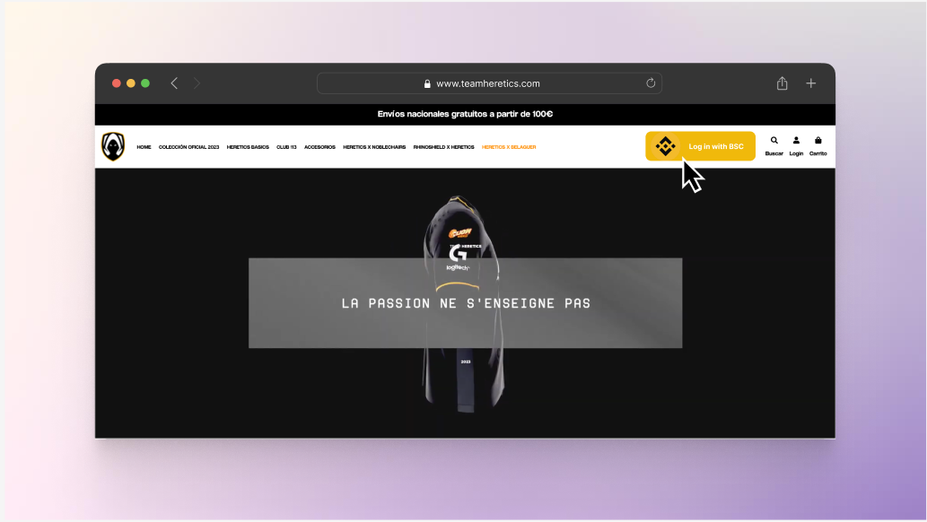

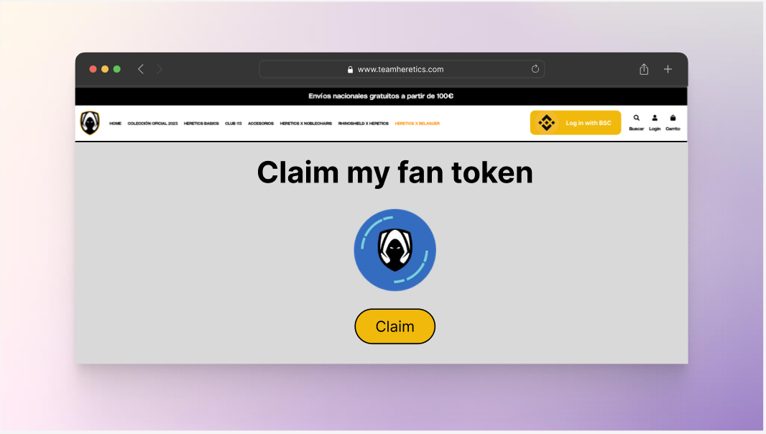
Once you are connected, you can claim your unique SBT Team Hereticsfan token.
Connect to Binance to unlock the button on Team Heretics official website.

Slide 15
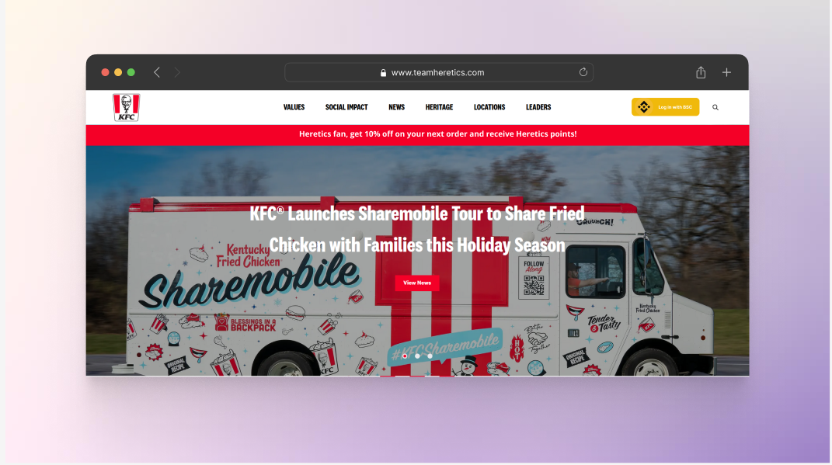
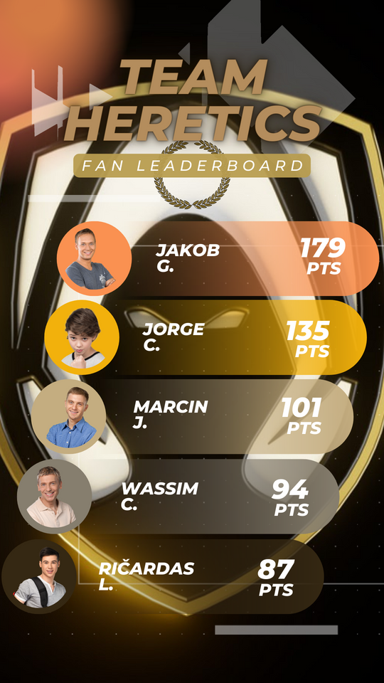
Once you claimed your token, here is what the sponsor website will look like.
End of the season leaderboard of generated points.

Slide 16
Project repo: https://github.com/Pulsar-Systems/heretics-binance-hackaton
In case the presentation does not show the video or images properly,
please use the following link :
https://www.canva.com/design/DAFVgOYxmXE/3gUmUR1kS-m69PrCxJaWNg/view?utm_content=DAFVgOYxmXE&utm_campaign=designshare&utm_medium=link&utm_source=publishsharelink

